Slide 1

Chandru Thenarasu
*

Slide 2

MVP (BOOk-World)
Mission
To create a App that resembles Big Basket shopping app.
Structure that was followed
Designed data base structure.
List of services to be used was written.
User-Interface was designed.

Slide 3
Implicit Requirements
Design category list and do the shopping based on the products
Select the brand and items
Initiate the payment
Create the user login
Select the product based on the brand names
Track the delivery status

Slide 4
Explicit Requirements
Create a scheme for employee with role and add their personal details.
Sepearate page for employees based on their role (i.e HR login & User Login).
User can see his profile and can edit his profile.
HR has access to view all the user profiles and can edit his own personal details.
User can apply for leave for a particular period of days initial status should be PENDING.
All the pending status of each user can be viewwd by HR.
HR can approve or decline the leave request for the particular user.
The approval or rejection status given by HR should reflect to each particular users.

Slide 5
Technologies used
flow chart

Slide 6
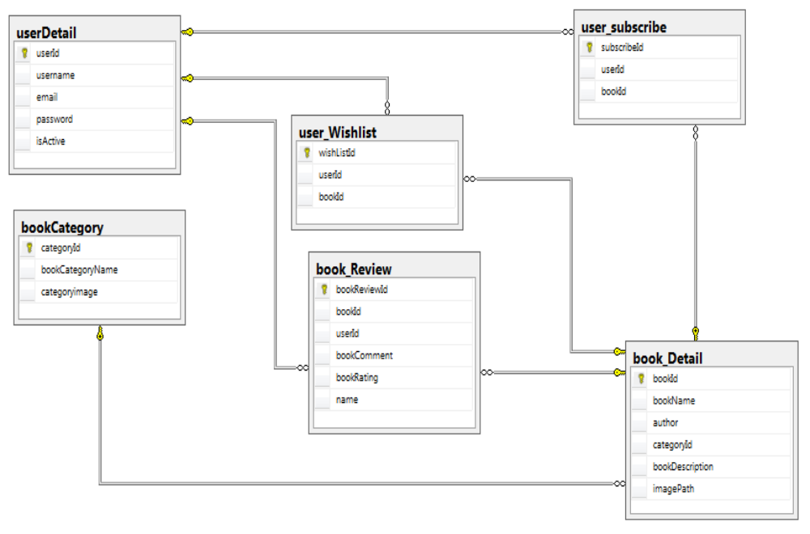
Database Design

Slide 7
technology used
Front End
AngularJS
UI
Html-5
CSS-3
Back End
Java
FrameWork
Hibernate
Jersy

Slide 8



